Slide 1
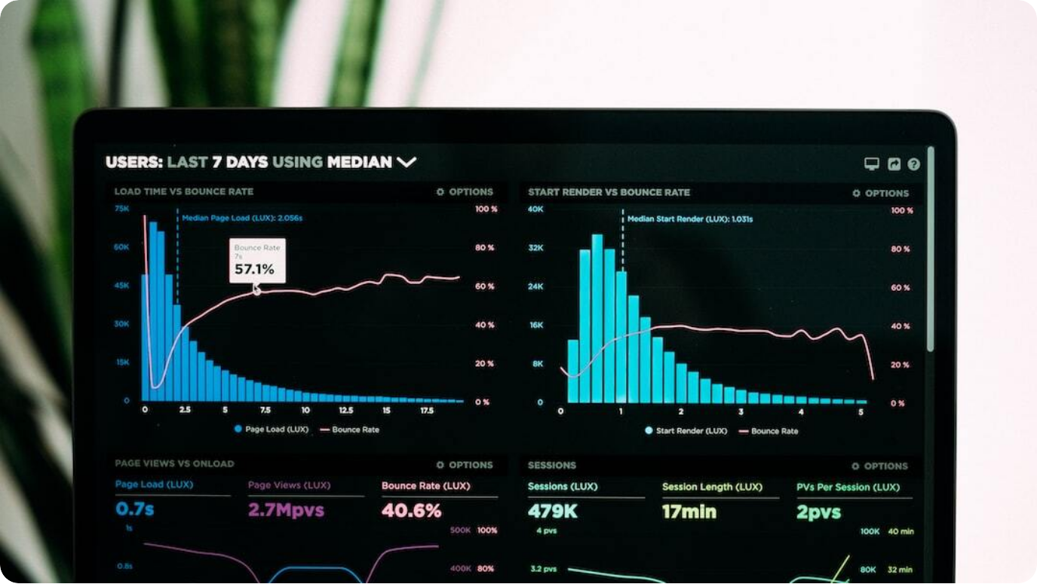
Unit 1 – Point 1.4: Data Types, Measures of Central Tendency, and Measures of Dispersion
Overview
Unit 1 – Point 1.4 Overview: Introduction to core statistical concepts relevant for data analytics: data types, measures of central tendency, and measures of dispersion.
Data Types: Classification of data into qualitative and quantitative categories with further subtypes.
Measures of Central Tendency: Mean, median, and mode as indicators of where the center of data lies.
Measures of Dispersion: Range, interquartile range, variance, and standard deviation to quantify data spread.
Photo by Luke Chesser on Unsplash
Notes:
Today we are covering Point 1.4 of Unit 1, which is the foundation of statistical analysis. We’ll start by learning about data types, then move on to measures of central tendency, which show where data is centered, and finally measures of dispersion, which explain how data is spread out.\n\nThis section sets the base for descriptive statistics. Central tendency shows a ‘typical’ value; dispersion explains variability. Both are essential for data interpretation in analytics.

Slide 2
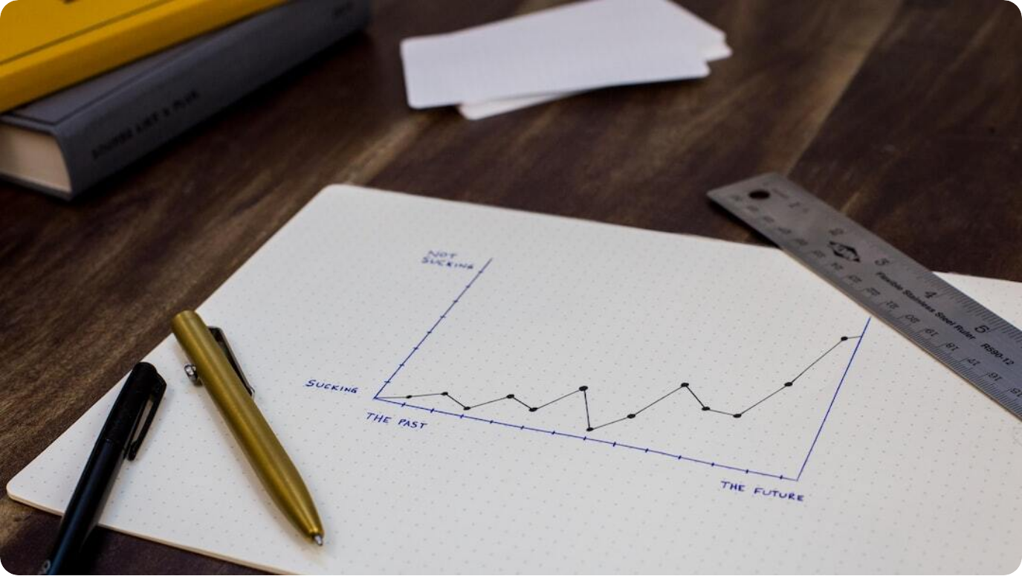
Data Types
Qualitative & Quantitative
Qualitative: Non-numeric, descriptive data such as colors, names, or categories.
Quantitative: Numeric data, further classified into interval and ratio scales.
Structured vs. Unstructured: Structured data stored in rows/columns vs. unstructured text, images, or videos.
Examples: Nominal (gender), Ordinal (rank), Interval (Celsius temperature), Ratio (weight).
Photo by Isaac Smith on Unsplash
Notes:
Data comes in different forms, and choosing the right analysis method depends on the type. Qualitative data is descriptive, like colors or labels, while quantitative data is numeric. Quantitative data can be interval, with equal spacing but no true zero, or ratio, with a meaningful zero point. We also distinguish between structured formats like Excel tables and unstructured formats like social media posts.\n\nNominal data represents categories without order, ordinal data has order but not measurable distance, interval data allows measurement without a true zero, and ratio data has both measurement and a true zero. Structured data is organized in databases, while unstructured data requires preprocessing before analysis.

Slide 3
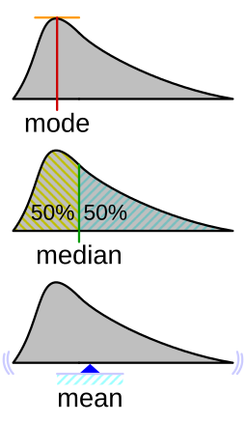
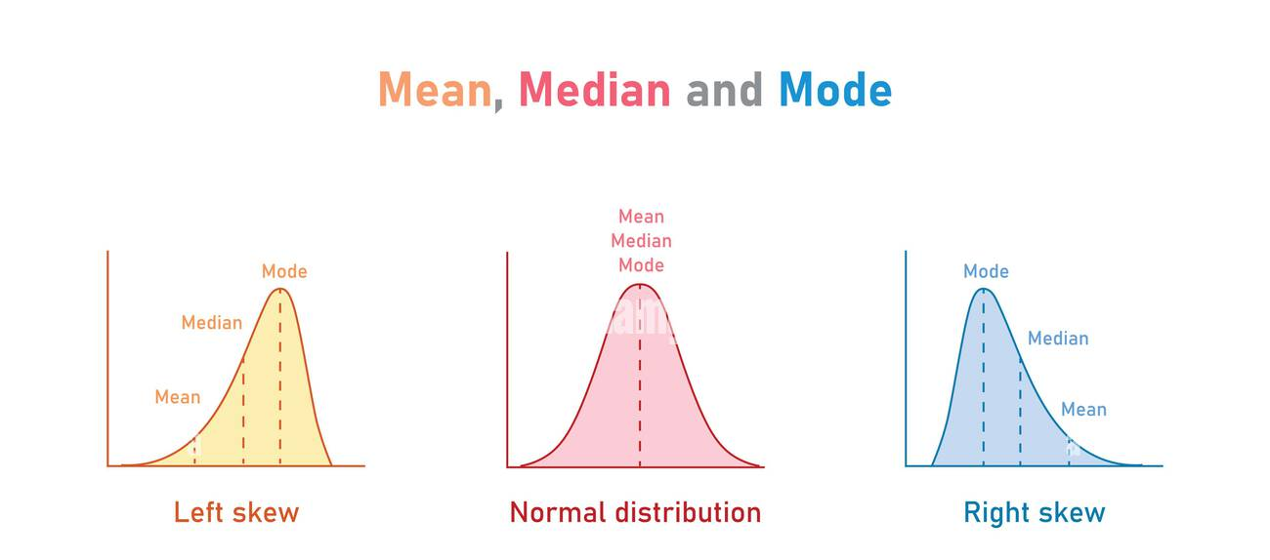
Introduction to Measures of Central Tendency
Finding the Center of Data
Shows the Center of Data: Central tendency summarizes the middle point of a dataset.
Common Measures: Mean, median, and mode are the primary statistics used.
Purpose: Identifies a representative value to simplify large datasets.
Notes:
Measures of central tendency summarize the center point of a dataset. The most common are mean, median, and mode. These help us understand what’s typical in our data.\n\nThe purpose is to condense large data into a single central value. Mean, median, and mode each have different strengths, and the choice depends on data type and the presence of outliers.

Slide 4
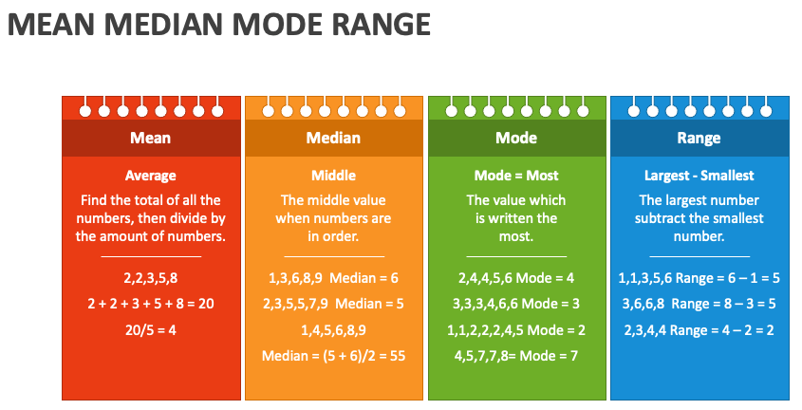
Introduction to Measures of Central Tendency
Finding the Center of Data
Notes:
Measures of central tendency summarize the center point of a dataset. The most common are mean, median, and mode. These help us understand what’s typical in our data.\n\nThe purpose is to condense large data into a single central value. Mean, median, and mode each have different strengths, and the choice depends on data type and the presence of outliers.

Slide 5
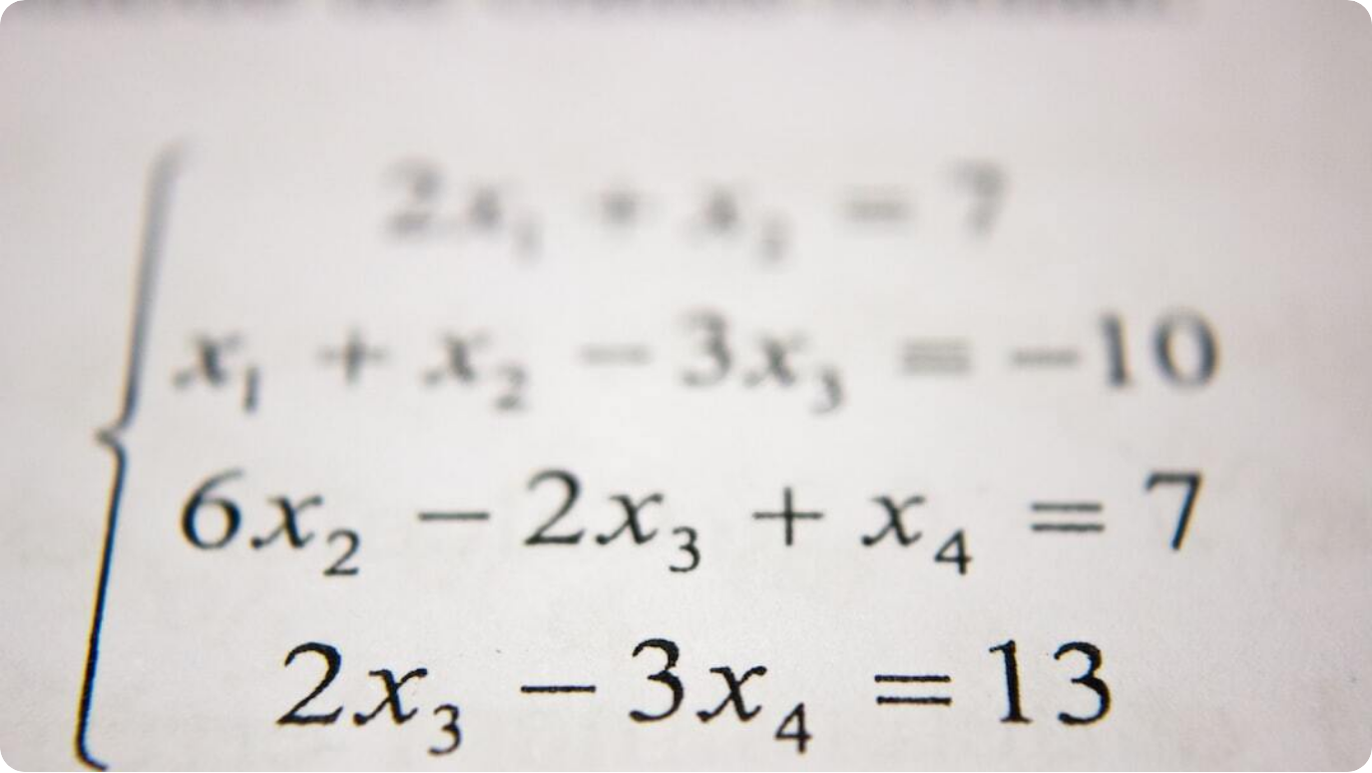
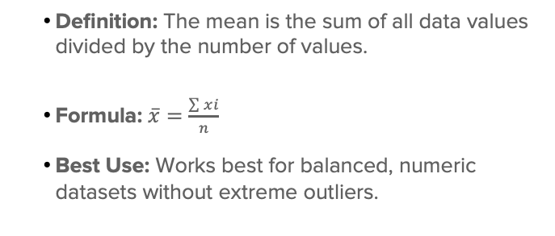
Mean: Concept & Formula
Arithmetic Average
Definition: The mean is the sum of all data values divided by the number of values.
Formula: $\overline{x}=\frac{\sum{xi}}{n}$
Best Use: Works best for balanced, numeric datasets without extreme outliers.
Photo by Antoine Dautry on Unsplash
Notes:
The mean, or average, is found by adding all data values and dividing by how many there are. It’s simple but can be skewed by extreme values.\n\nIt’s sensitive to all values, which makes it very responsive to changes in data but also vulnerable to outliers. Common applications include KPIs and performance tracking.

Slide 6
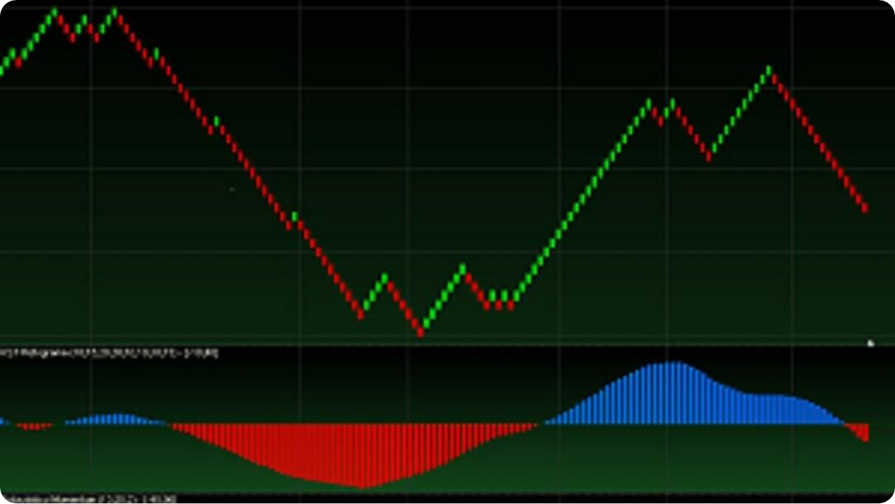
Mean: Graphical Visualization
The Balance Point
Reference Line: The mean can be represented as a horizontal line across data plots.
Balance Point: Acts as the equilibrium where data values balance out.
Symmetry vs. Skew: In symmetric distributions, the mean is central; in skewed data, it shifts toward the tail.
Photo by Jianu tr on Unsplash
Notes:
Graphically, the mean appears as a balance point. In a line or bar chart, it’s a horizontal reference line around which data clusters. In a perfectly symmetric distribution, the mean sits right in the middle. However, in skewed data, the mean shifts toward the tail of the distribution.

Slide 7
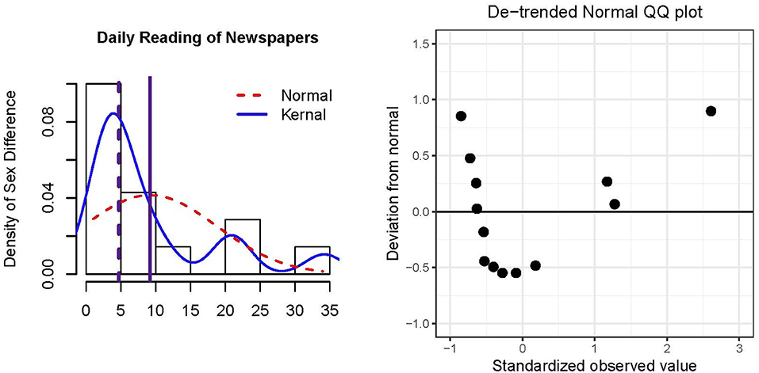
Mean: Graphical Visualization
The Reference Line
Photo by Jianu tr on Unsplash
This Photo by Unknown Author is licensed under CC BY
Notes:
Graphically, the mean appears as a balance point. In a line or bar chart, it’s a horizontal reference line around which data clusters. In a perfectly symmetric distribution, the mean sits right in the middle. However, in skewed data, the mean shifts toward the tail of the distribution.

Slide 8
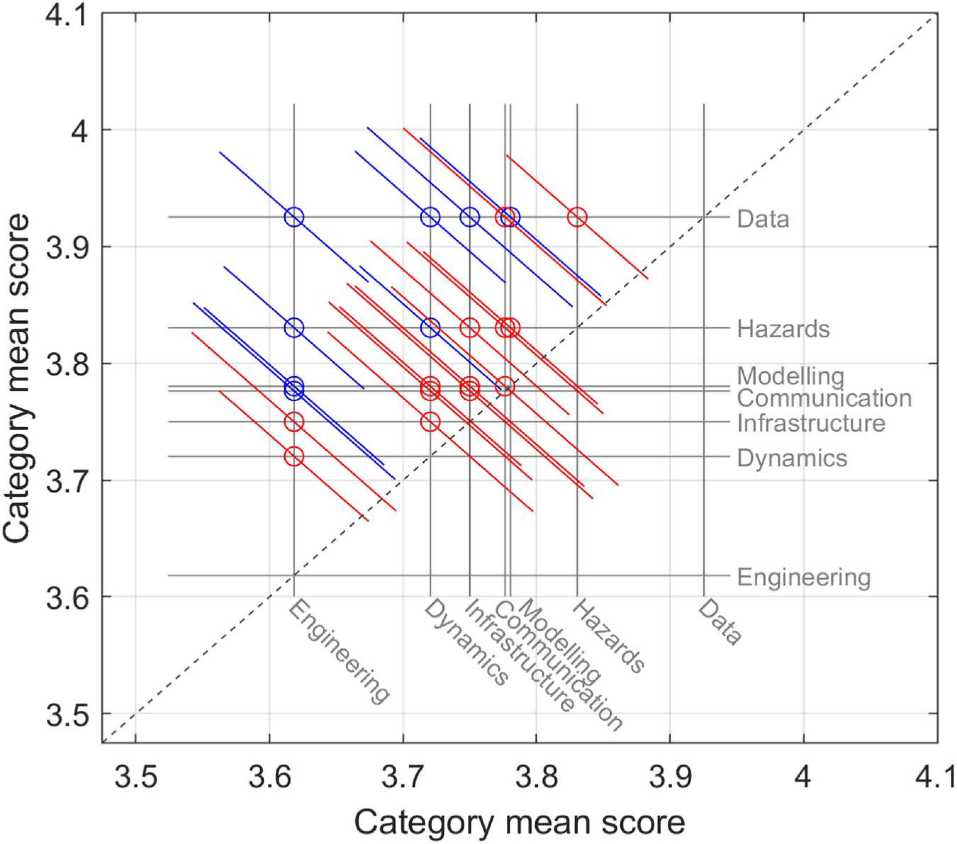
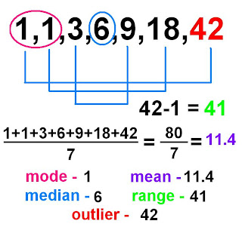
Mean: Graphical Visualization
The Reference Line
This Photo by Unknown Author is licensed under CC BY
Notes:
Graphically, the mean appears as a balance point. In a line or bar chart, it’s a horizontal reference line around which data clusters. In a perfectly symmetric distribution, the mean sits right in the middle. However, in skewed data, the mean shifts toward the tail of the distribution.

Slide 9
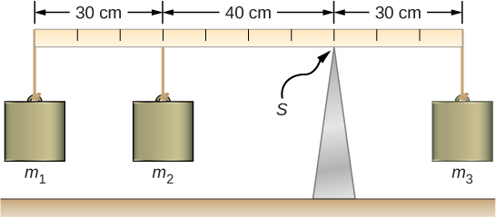
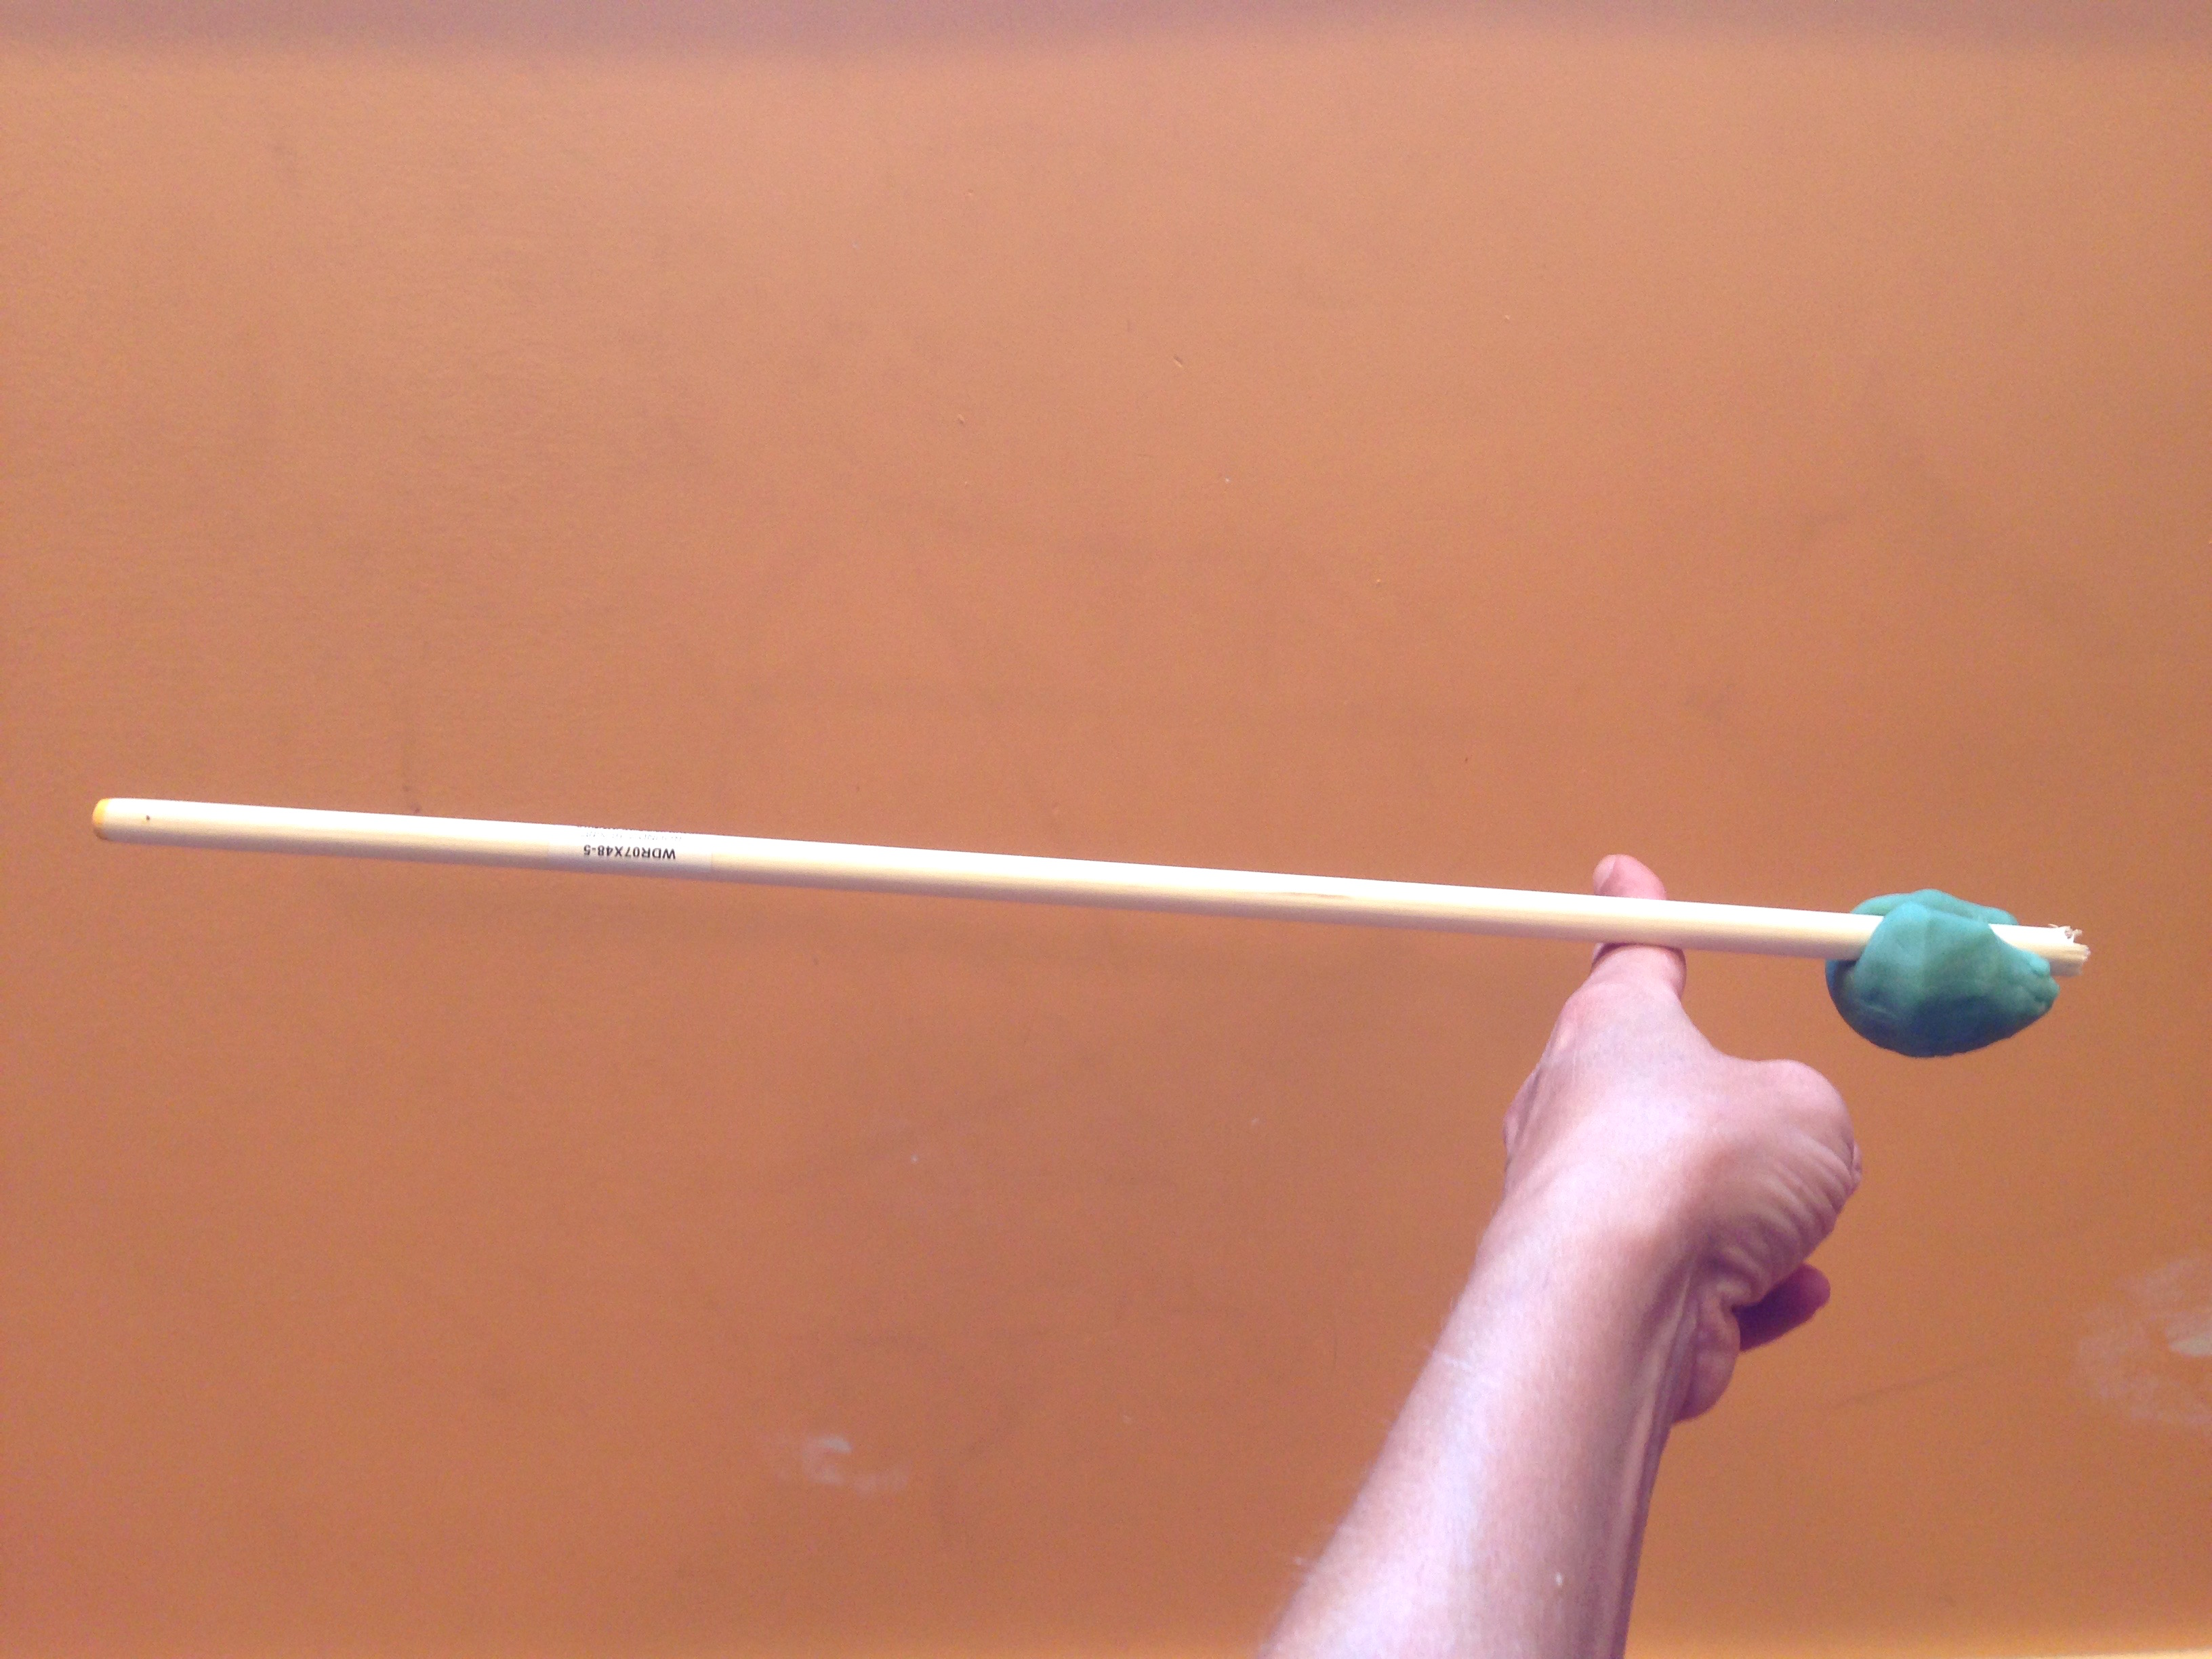
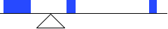
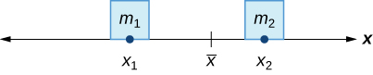
Mean: Graphical Visualization
The Balance Point
This Photo by Unknown Author is licensed under CC BY-SA-NC
Notes:
Graphically, the mean appears as a balance point. In a line or bar chart, it’s a horizontal reference line around which data clusters. In a perfectly symmetric distribution, the mean sits right in the middle. However, in skewed data, the mean shifts toward the tail of the distribution.

Slide 10
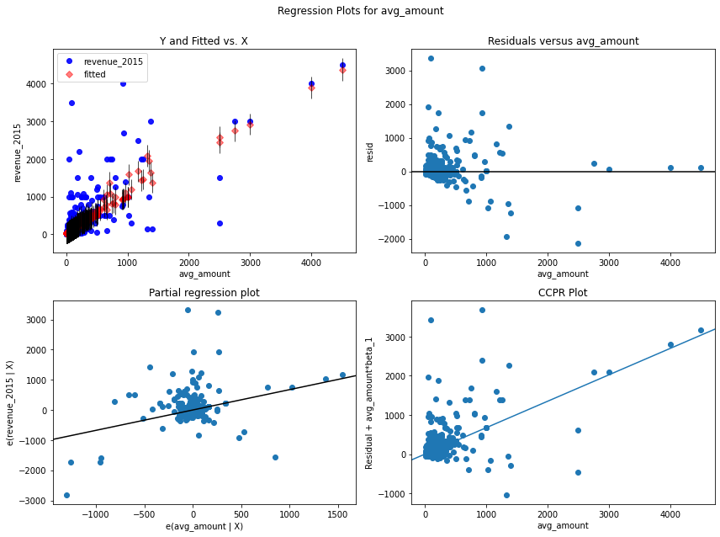
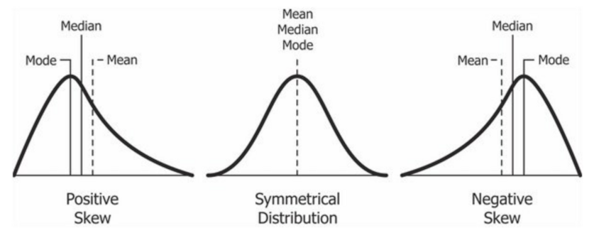
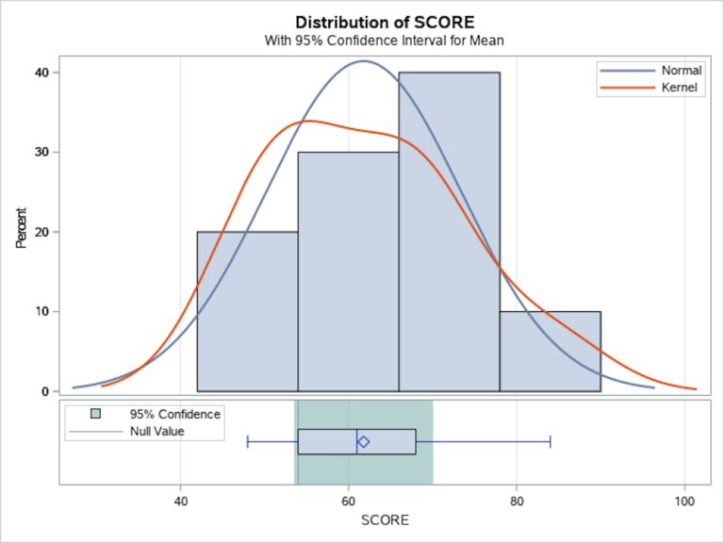
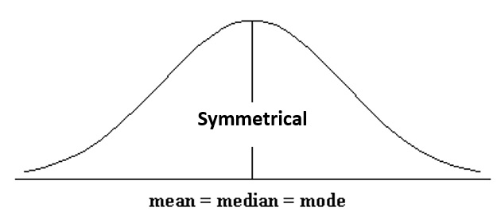
Mean: Graphical Visualization
Symmetry vs. Skew
Notes:
Graphically, the mean appears as a balance point. In a line or bar chart, it’s a horizontal reference line around which data clusters. In a perfectly symmetric distribution, the mean sits right in the middle. However, in skewed data, the mean shifts toward the tail of the distribution.

Slide 11



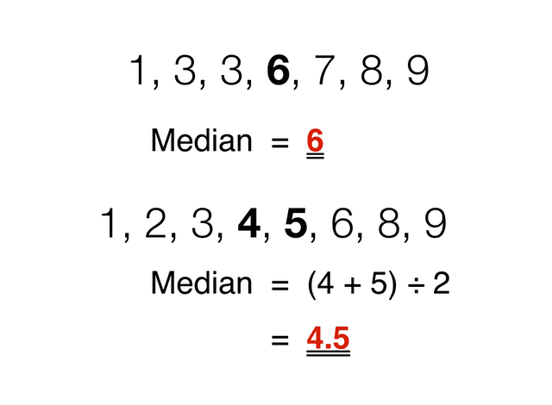
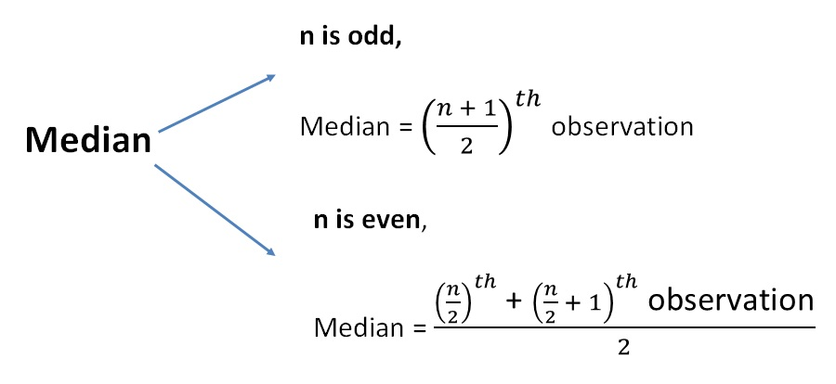
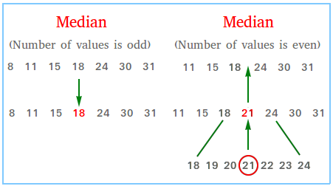
Median: Concept & Formula
Middle Value in Ordered Data
Definition
The median is the middle value when data is ordered from smallest to largest.
Even Data Sets
If the dataset size is even, the median is the average of the two middle values.
Resistant to Outliers
Less affected by extreme values compared to the mean.
Notes:
The median is the middle value when data is ordered. If there’s an even number of data points, it’s the average of the two middle values. It’s a better choice than the mean when dealing with skewed data or outliers.\n\nExample: Sorted [1, 2, 4, 6, 9] → median = 4. For even counts, take the mean of the middle pair.

Slide 12
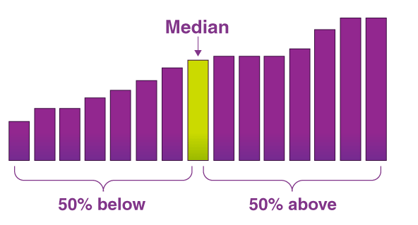
Median: Graphical Visualization
Box Plot Representation
Median Line: Shown as the line inside the box of a box plot.
Data Halves: Splits dataset into two equal parts.
Outlier Detection: Box plots highlight extreme values beyond whiskers.
Notes:
In a box plot, the median is the line inside the box, dividing the dataset into two equal halves. The box itself shows the interquartile range (IQR), while the whiskers extend to the smallest and largest values within a set range. Outliers beyond the whiskers are marked as individual points, making box plots powerful for identifying skewness and variability.

Slide 13
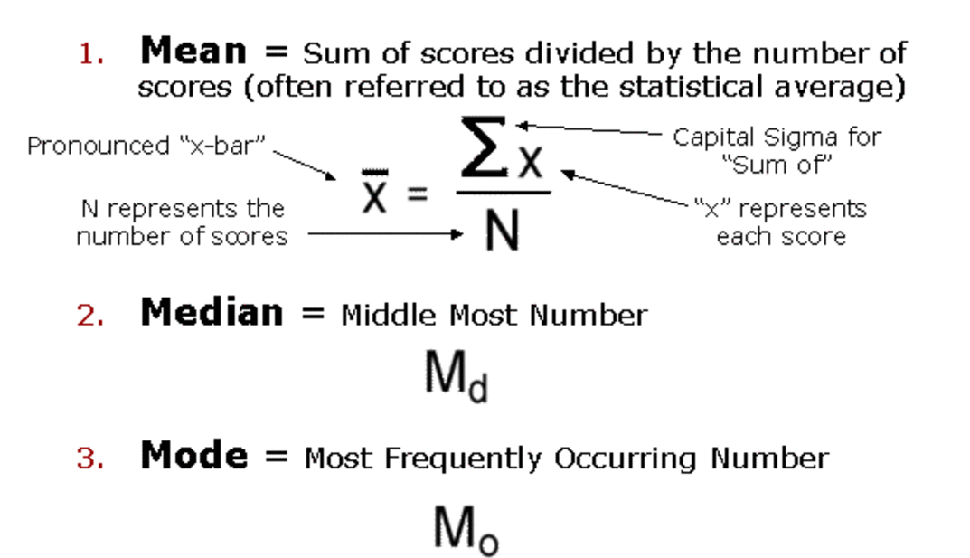
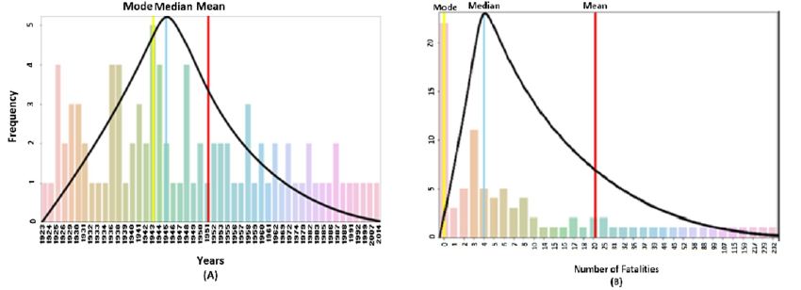
Mode: Concept & Formula
Most Frequent Value
Definition: The mode is the value that appears most often in a dataset.
Multiplicity: Can be unimodal, bimodal, or multimodal depending on data.
Best Use: Ideal for categorical data and detecting common values.
Notes:
The mode is the most frequent data value. A dataset can have one mode, two modes, or more.\n\nIt’s especially useful for categorical data, where mean and median may not make sense. For example: [2, 4, 4, 5, 7] → mode = 4.

Slide 14
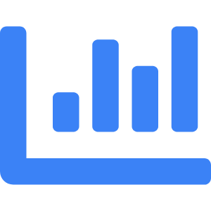


Mode: Graphical Visualization
Frequency Peaks
Histogram Peaks
The highest bar in a histogram represents the mode.
Multiple Modes
Multiple peaks indicate bimodal or multimodal distributions.
Pattern Detection
Modes reveal data clustering and subgroup patterns.
Notes:
In a histogram, the mode is the peak of the distribution — the value with the highest frequency. Histograms can also reveal multiple peaks, which may indicate subgroups within the dataset. This makes mode analysis useful for detecting distinct clusters in data.

Slide 15
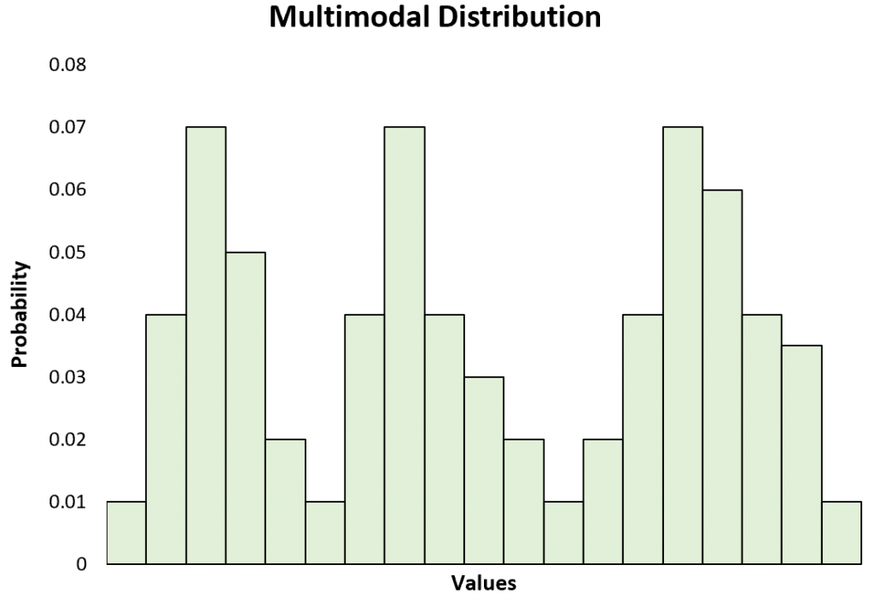
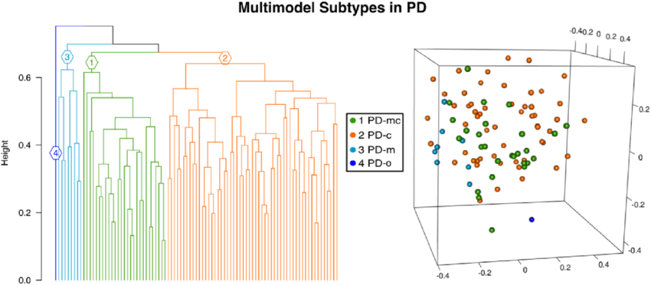
Mode: Graphical Visualization
Multiple Modes
Multiple peaks indicate bimodal or multimodal distributions.
Notes:
In a histogram, the mode is the peak of the distribution — the value with the highest frequency. Histograms can also reveal multiple peaks, which may indicate subgroups within the dataset. This makes mode analysis useful for detecting distinct clusters in data.

Slide 16
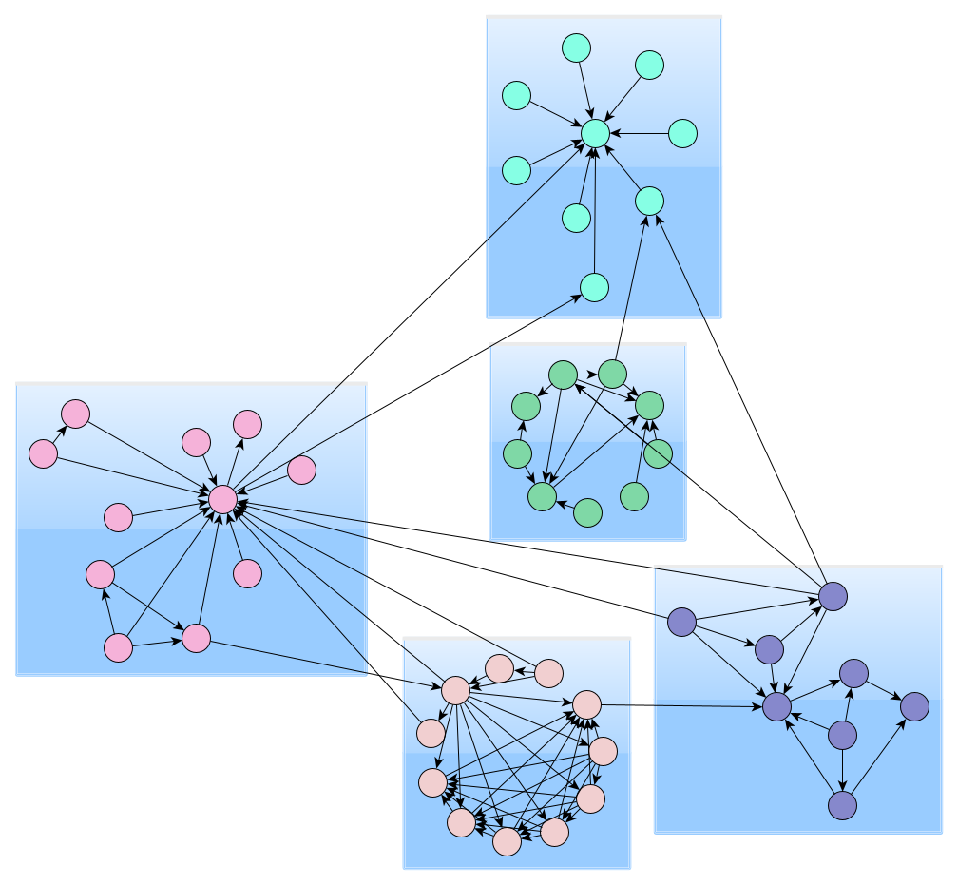
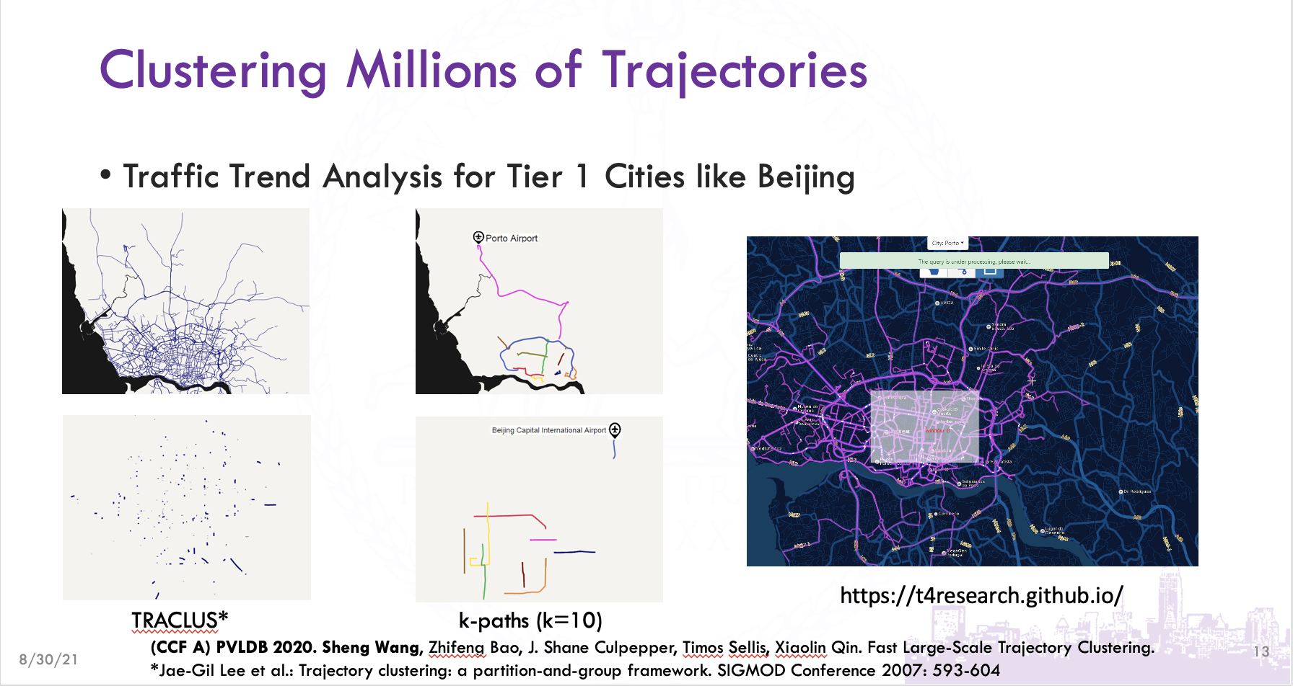
Mode: Graphical Visualization
Notes:
In a histogram, the mode is the peak of the distribution — the value with the highest frequency. Histograms can also reveal multiple peaks, which may indicate subgroups within the dataset. This makes mode analysis useful for detecting distinct clusters in data.

Slide 17
Introduction to Measures of Dispersion
Understanding Data Spread
Definition: Measures of dispersion quantify how data points vary around the central value.
Common Measures: Range, interquartile range, variance, and standard deviation.
Purpose: Complements central tendency by showing variability and reliability.
Photo by Isaac Smith on Unsplash
Notes:
Measures of dispersion show how much data varies. They complement central tendency by revealing if data points are close to the center or widely spread. Common measures include range, interquartile range, variance, and standard deviation, each offering unique insights into data variability.

Slide 18
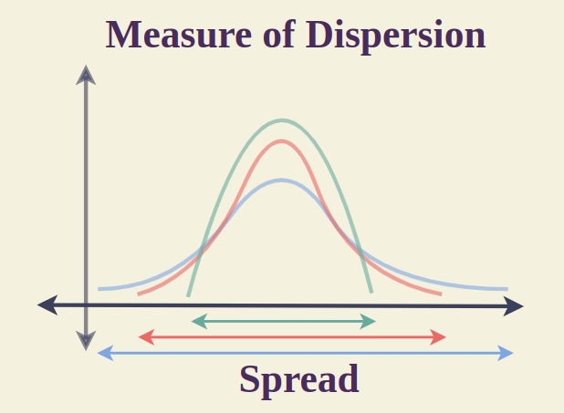
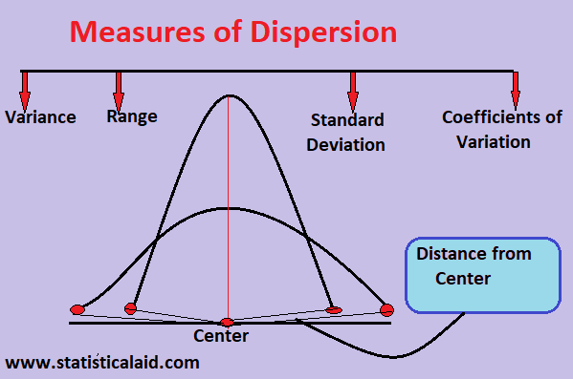
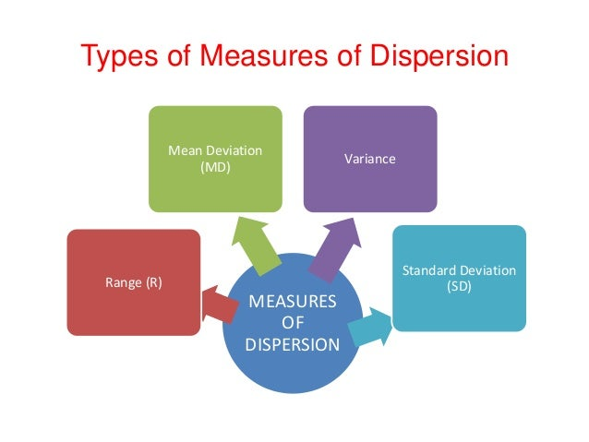
Introduction to Measures of Dispersion
Understanding Data Spread
Notes:
Measures of dispersion show how much data varies. They complement central tendency by revealing if data points are close to the center or widely spread. Common measures include range, interquartile range, variance, and standard deviation, each offering unique insights into data variability.

Slide 19
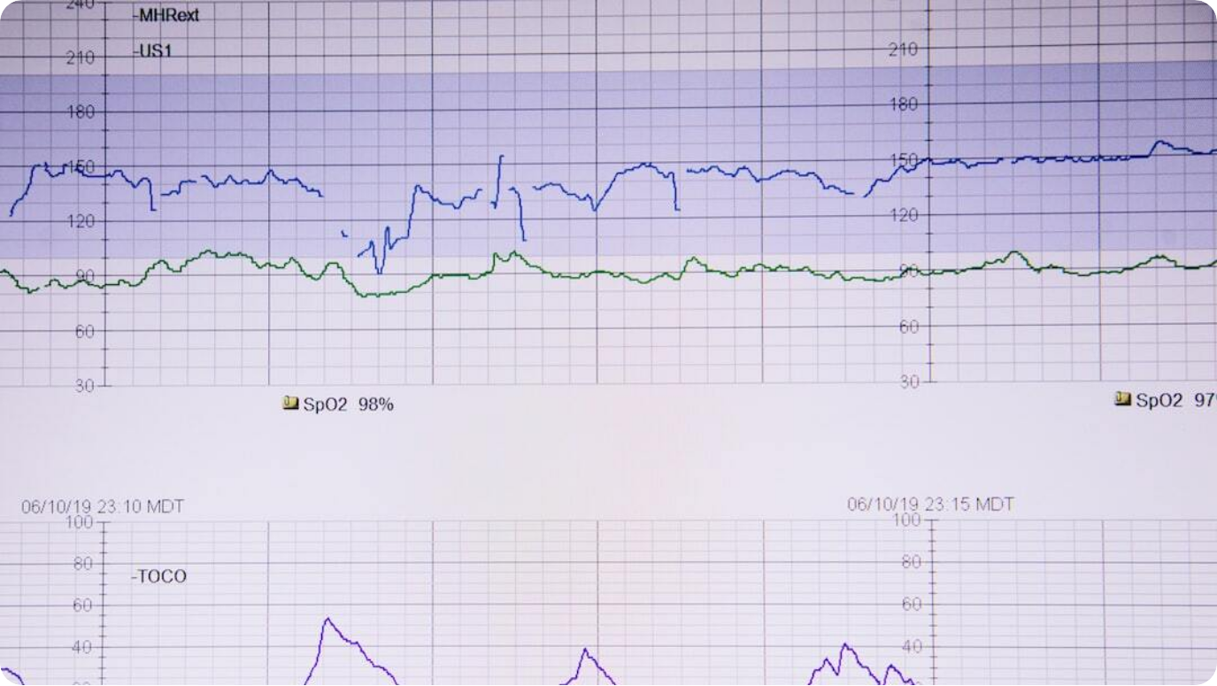
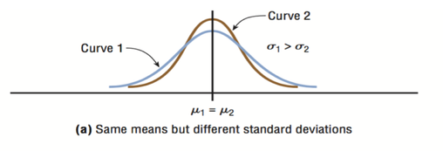
Significance of Understanding Data Spread
Variability and Reliability
Reliability: Data spread affects the consistency of conclusions.
Outlier Detection: Helps identify extreme values that may distort analysis.
Same Mean, Different Spread: Two datasets with identical means can differ significantly in variability.
Photo by Alexander Grey on Unsplash
Notes:
Understanding spread is crucial. Two datasets can have the same mean but very different spreads, leading to distinct interpretations. Low spread means more consistency, while high spread indicates greater uncertainty and potential risk. This is critical in fields like finance, manufacturing, and healthcare.

Slide 20
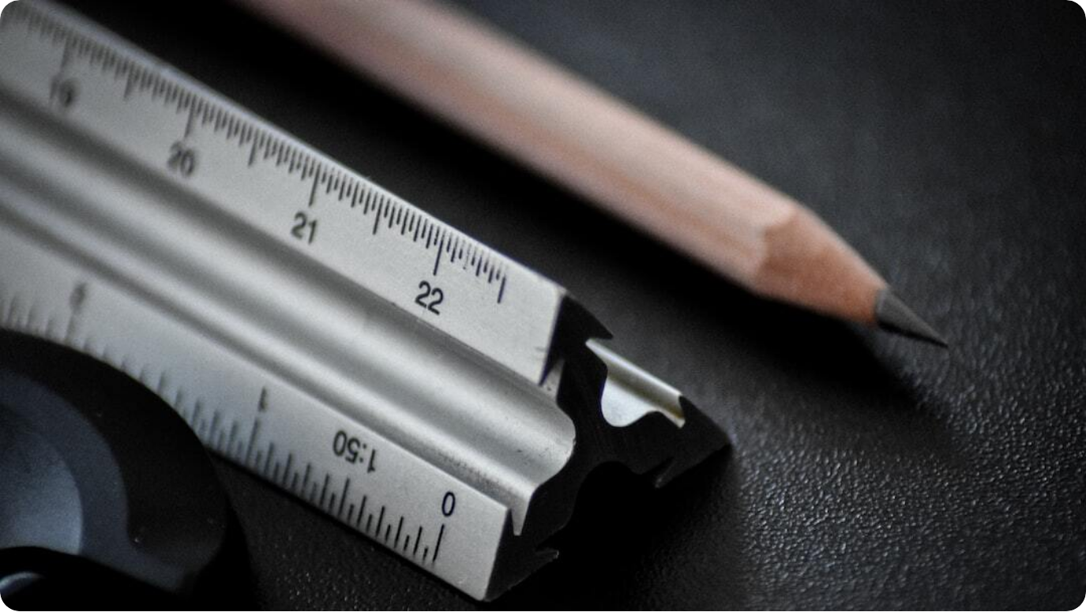
Range
Simplest Measure of Spread
Formula: Range = Maximum Value − Minimum Value.
Quick Measure: Easy to compute but sensitive to outliers.
Example: [5, 7, 8, 12] → Range = 12 − 5 = 7.
Photo by Sven Mieke on Unsplash
Notes:
Range is the simplest dispersion measure: subtract the smallest value from the largest. While quick to compute, it’s very sensitive to outliers and doesn’t reflect the shape of the distribution.

Slide 21

Interquartile Range (IQR)
Middle 50% Spread
Formula: IQR = Q3 − Q1.
Robustness: Less affected by extreme values than range.
Example: Q1 = 5, Q3 = 15 → IQR = 10.
Photo by Ricardo Arce on Unsplash
Notes:
The interquartile range (IQR) measures the spread of the middle half of the data. It’s calculated as Q3 minus Q1 and is less affected by extreme values than the range. Box plots often display IQR and use it to detect outliers.

Slide 22


Visualizing Range, Quartile Range, and IQR
Box Plot Example with Dataset: 4, 7, 9, 15, 20
Range
The full spread from minimum to maximum value (20 - 4 = 16), shown as whiskers in the plot.
Quartile Range
Spread between any two quartiles; in this example, Q3 - Q2 or Q2 - Q1 could be shown in shaded segments.
Interquartile Range (IQR)
The middle 50% of the data, Q3 - Q1 (15 - 7 = 8), highlighted as the central box in the plot.
Notes:
This box plot condenses our dataset into a simple yet powerful visual. The whiskers extend from the minimum value (4) to the maximum value (20), representing the total range of 16. Quartiles divide the dataset into four equal parts — Q1 at 7, median Q2 at 9, and Q3 at 15. The interquartile range (IQR) is the distance from Q1 to Q3, in this case 8, and it captures the middle 50% of the data.
By showing the range, quartile ranges, and IQR in one diagram, we can immediately see how each measure captures a different aspect of spread. The range is simple but sensitive to extreme values, while the IQR is more robust, ignoring potential outliers. Quartile ranges allow us to focus on upper or lower halves specifically.
When interpreting box plots, keep in mind that extreme points beyond the whiskers may indicate outliers — values unusually far from the rest of the dataset.

Slide 23



Understanding Range in Statistics
Definition, Calculation, and Uses
Definition
Range is the difference between the largest and smallest values in a dataset.
Example
For the dataset 4, 7, 9, 15, 20 → Range = 20 - 4 = 16.
Uses and Limitation
Quick measure of spread; highly sensitive to extreme values or outliers.
Notes:
Range is the simplest way to measure the spread of a dataset. It takes just two values — the maximum and the minimum — and subtracts them to show the total span of the data. For example, in our dataset of 4, 7, 9, 15, and 20, the range is 20 minus 4, which equals 16.
This measure is appealing because of its simplicity and speed of calculation. However, it can be misleading if the dataset contains an extreme value. A single unusually high or low observation can greatly inflate the range, making the data seem more spread out than it really is.
In practice, the range is useful as a quick first glance at variability, but it’s often paired with more robust measures to account for data skew and outliers.

Slide 24

Quartile Range & Interquartile Range (IQR)
Breaking Down Quartiles and Middle Spread
Quartiles
Q1 (25%), Q2 (median, 50%), and Q3 (75%) divide ordered data into four equal parts.
Quartile Range
Spread between any two quartiles (e.g., Q3 – Q2 or Q2 – Q1).
IQR
Middle 50% of data, calculated as Q3 – Q1. Robust to outliers.
Notes:
Quartiles are key markers in any ordered dataset, dividing the data into four equal parts. Q1 marks the 25% point, Q2 is the median at 50%, and Q3 marks the 75% point. These points allow us to examine spread within specific portions of the data.
A quartile range is simply the distance between any two quartiles. While the most common quartile range is Q3 minus Q1 — known as the interquartile range — you can also examine Q3 – Q2 or Q2 – Q1 to look at spread in the upper or lower halves specifically.
The IQR, representing the middle 50% of the dataset, is especially valuable because it ignores extreme low or high values, providing a more reliable measure of typical spread in skewed datasets.

Slide 25
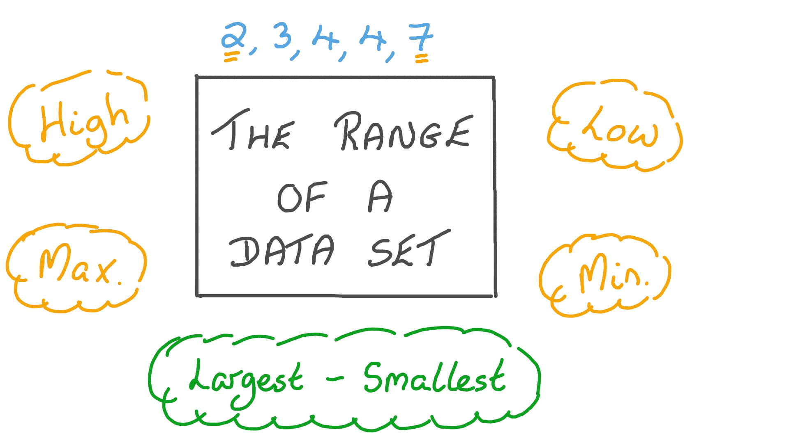
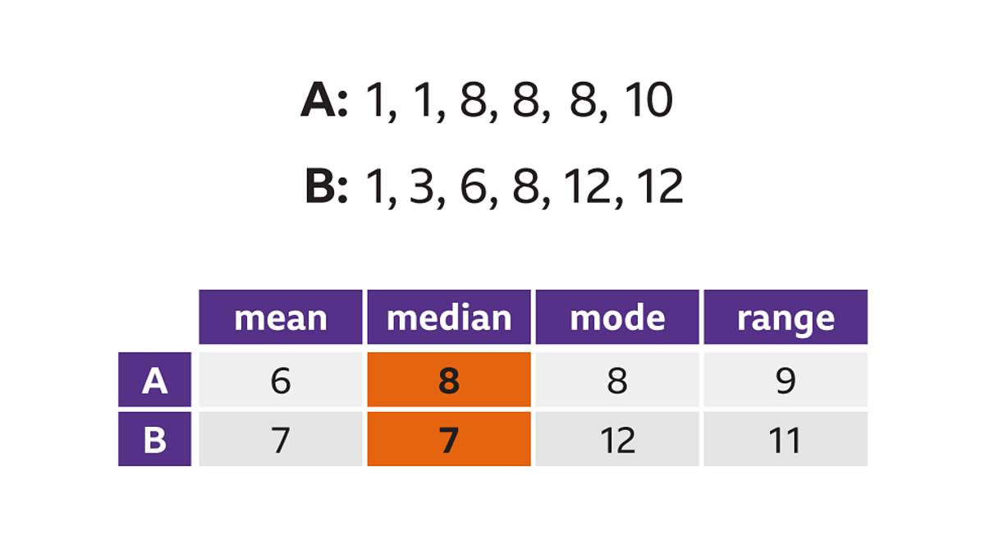
Visualizing Range, Quartile Range, and IQR
Range
Notes:
This box plot condenses our dataset into a simple yet powerful visual. The whiskers extend from the minimum value (4) to the maximum value (20), representing the total range of 16. Quartiles divide the dataset into four equal parts — Q1 at 7, median Q2 at 9, and Q3 at 15. The interquartile range (IQR) is the distance from Q1 to Q3, in this case 8, and it captures the middle 50% of the data.
By showing the range, quartile ranges, and IQR in one diagram, we can immediately see how each measure captures a different aspect of spread. The range is simple but sensitive to extreme values, while the IQR is more robust, ignoring potential outliers. Quartile ranges allow us to focus on upper or lower halves specifically.
When interpreting box plots, keep in mind that extreme points beyond the whiskers may indicate outliers — values unusually far from the rest of the dataset.

Slide 26
Visualizing Range, Quartile Range, and IQR
Quartile and Interquartile Range
Notes:
This box plot condenses our dataset into a simple yet powerful visual. The whiskers extend from the minimum value (4) to the maximum value (20), representing the total range of 16. Quartiles divide the dataset into four equal parts — Q1 at 7, median Q2 at 9, and Q3 at 15. The interquartile range (IQR) is the distance from Q1 to Q3, in this case 8, and it captures the middle 50% of the data.
By showing the range, quartile ranges, and IQR in one diagram, we can immediately see how each measure captures a different aspect of spread. The range is simple but sensitive to extreme values, while the IQR is more robust, ignoring potential outliers. Quartile ranges allow us to focus on upper or lower halves specifically.
When interpreting box plots, keep in mind that extreme points beyond the whiskers may indicate outliers — values unusually far from the rest of the dataset.

Slide 27
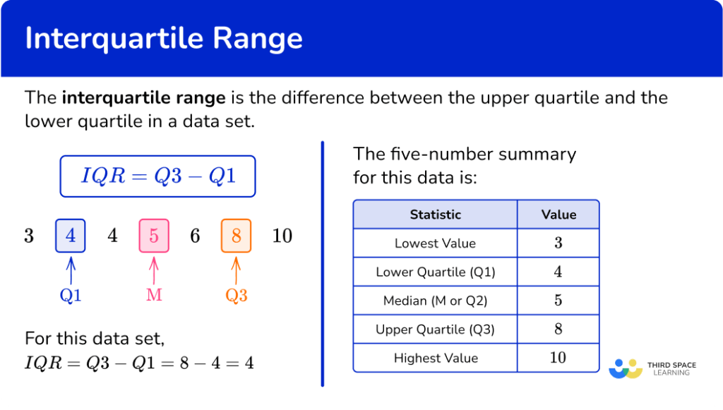
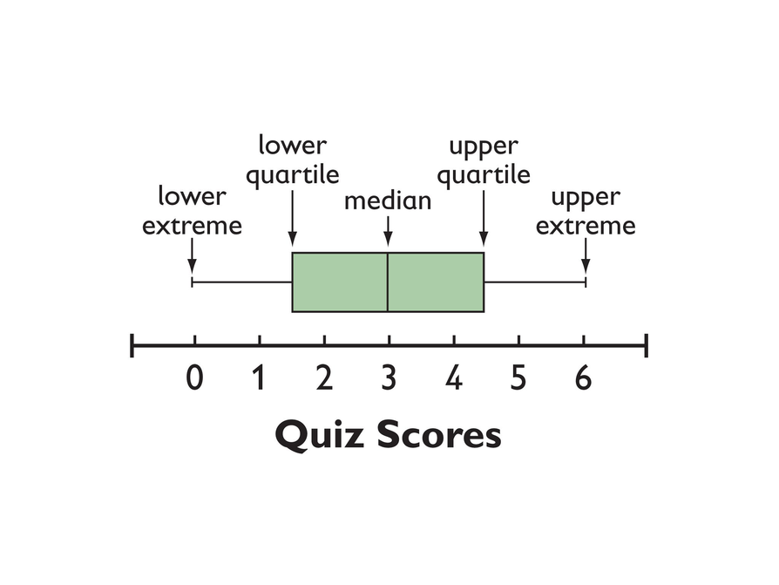
Visualizing Range, Quartile Range, and IQR
Quartile and Interquartile Range
Notes:
This box plot condenses our dataset into a simple yet powerful visual. The whiskers extend from the minimum value (4) to the maximum value (20), representing the total range of 16. Quartiles divide the dataset into four equal parts — Q1 at 7, median Q2 at 9, and Q3 at 15. The interquartile range (IQR) is the distance from Q1 to Q3, in this case 8, and it captures the middle 50% of the data.
By showing the range, quartile ranges, and IQR in one diagram, we can immediately see how each measure captures a different aspect of spread. The range is simple but sensitive to extreme values, while the IQR is more robust, ignoring potential outliers. Quartile ranges allow us to focus on upper or lower halves specifically.
When interpreting box plots, keep in mind that extreme points beyond the whiskers may indicate outliers — values unusually far from the rest of the dataset.

Slide 28
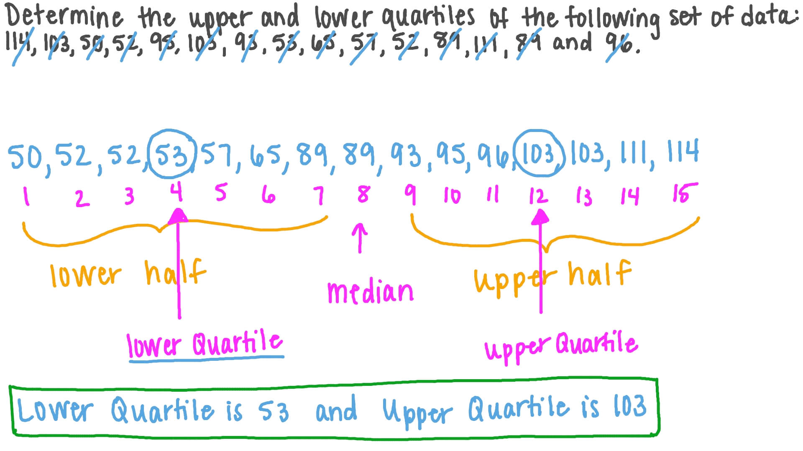
Visualizing Range, Quartile Range, and IQR
Quartile and Interquartile Range
Notes:
This box plot condenses our dataset into a simple yet powerful visual. The whiskers extend from the minimum value (4) to the maximum value (20), representing the total range of 16. Quartiles divide the dataset into four equal parts — Q1 at 7, median Q2 at 9, and Q3 at 15. The interquartile range (IQR) is the distance from Q1 to Q3, in this case 8, and it captures the middle 50% of the data.
By showing the range, quartile ranges, and IQR in one diagram, we can immediately see how each measure captures a different aspect of spread. The range is simple but sensitive to extreme values, while the IQR is more robust, ignoring potential outliers. Quartile ranges allow us to focus on upper or lower halves specifically.
When interpreting box plots, keep in mind that extreme points beyond the whiskers may indicate outliers — values unusually far from the rest of the dataset.

Slide 29
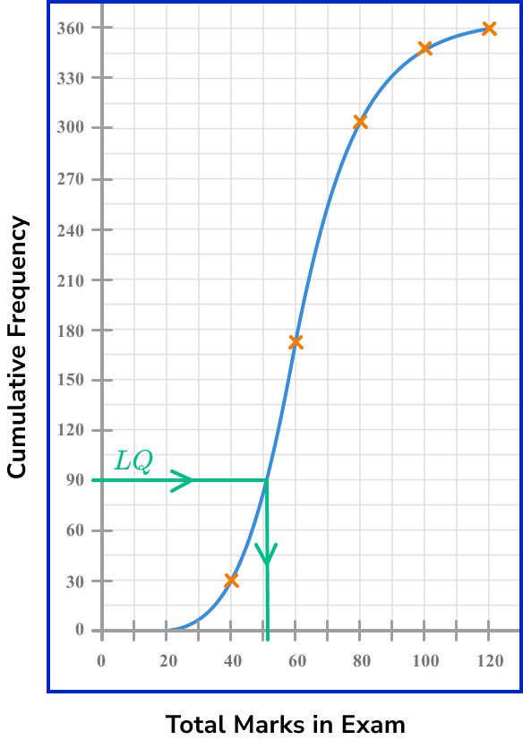
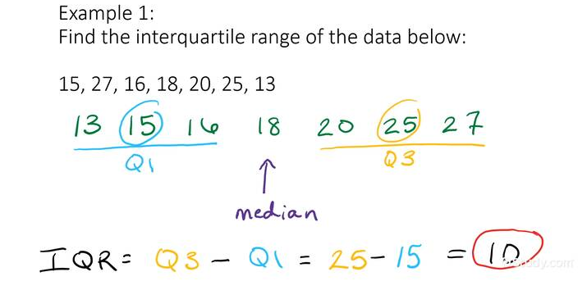
Visualizing Range, Quartile Range, and IQR
Quartile and Interquartile Range
Notes:
This box plot condenses our dataset into a simple yet powerful visual. The whiskers extend from the minimum value (4) to the maximum value (20), representing the total range of 16. Quartiles divide the dataset into four equal parts — Q1 at 7, median Q2 at 9, and Q3 at 15. The interquartile range (IQR) is the distance from Q1 to Q3, in this case 8, and it captures the middle 50% of the data.
By showing the range, quartile ranges, and IQR in one diagram, we can immediately see how each measure captures a different aspect of spread. The range is simple but sensitive to extreme values, while the IQR is more robust, ignoring potential outliers. Quartile ranges allow us to focus on upper or lower halves specifically.
When interpreting box plots, keep in mind that extreme points beyond the whiskers may indicate outliers — values unusually far from the rest of the dataset.

Slide 30
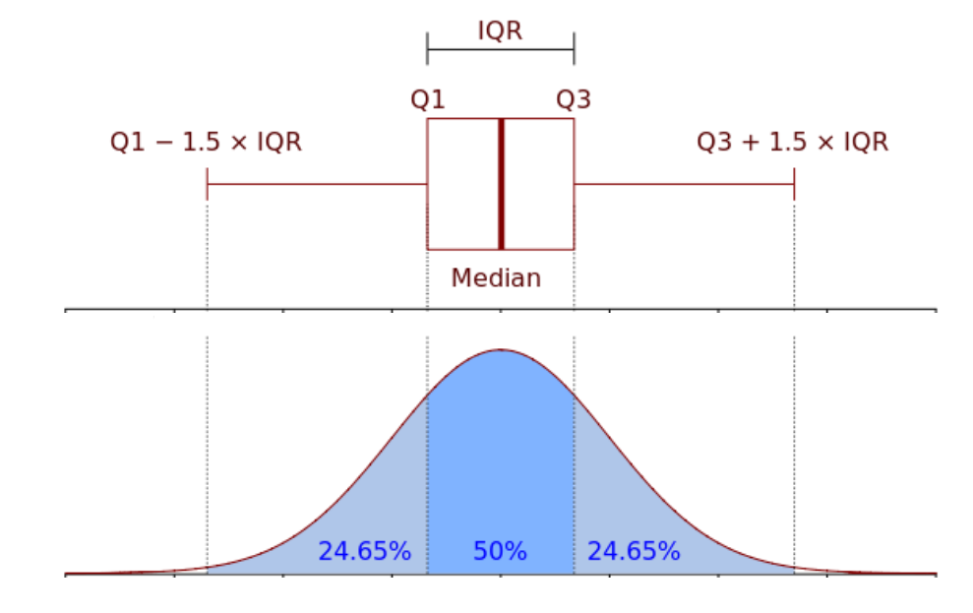
Visualizing Range, Quartile Range, and IQR
Quartile and Interquartile Range
Notes:
This box plot condenses our dataset into a simple yet powerful visual. The whiskers extend from the minimum value (4) to the maximum value (20), representing the total range of 16. Quartiles divide the dataset into four equal parts — Q1 at 7, median Q2 at 9, and Q3 at 15. The interquartile range (IQR) is the distance from Q1 to Q3, in this case 8, and it captures the middle 50% of the data.
By showing the range, quartile ranges, and IQR in one diagram, we can immediately see how each measure captures a different aspect of spread. The range is simple but sensitive to extreme values, while the IQR is more robust, ignoring potential outliers. Quartile ranges allow us to focus on upper or lower halves specifically.
When interpreting box plots, keep in mind that extreme points beyond the whiskers may indicate outliers — values unusually far from the rest of the dataset.

Slide 31

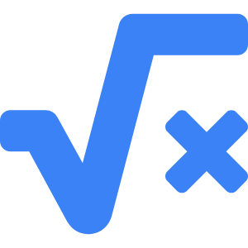

Variance
Average Squared Deviation
Definition
Variance is the mean of squared differences from the mean.
Formula
σ² = Σ(xᵢ − x̄)² / n
Use Cases
Applied in statistical modeling, ANOVA, and risk measurement.
Notes:
Variance measures the average squared distance from the mean. It is expressed in squared units, making it less intuitive than standard deviation, but it’s essential for many statistical models and analyses. Higher variance indicates greater data spread.

Slide 32
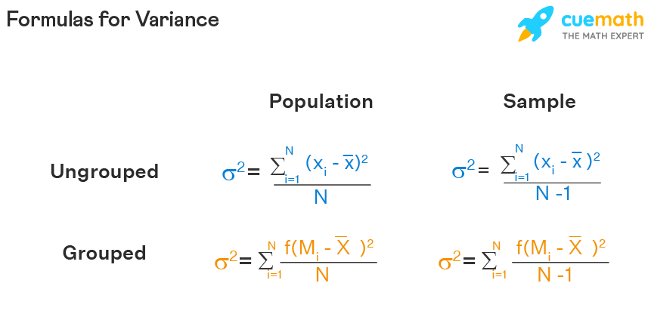
Variance
Notes:
Variance measures the average squared distance from the mean. It is expressed in squared units, making it less intuitive than standard deviation, but it’s essential for many statistical models and analyses. Higher variance indicates greater data spread.

Slide 33
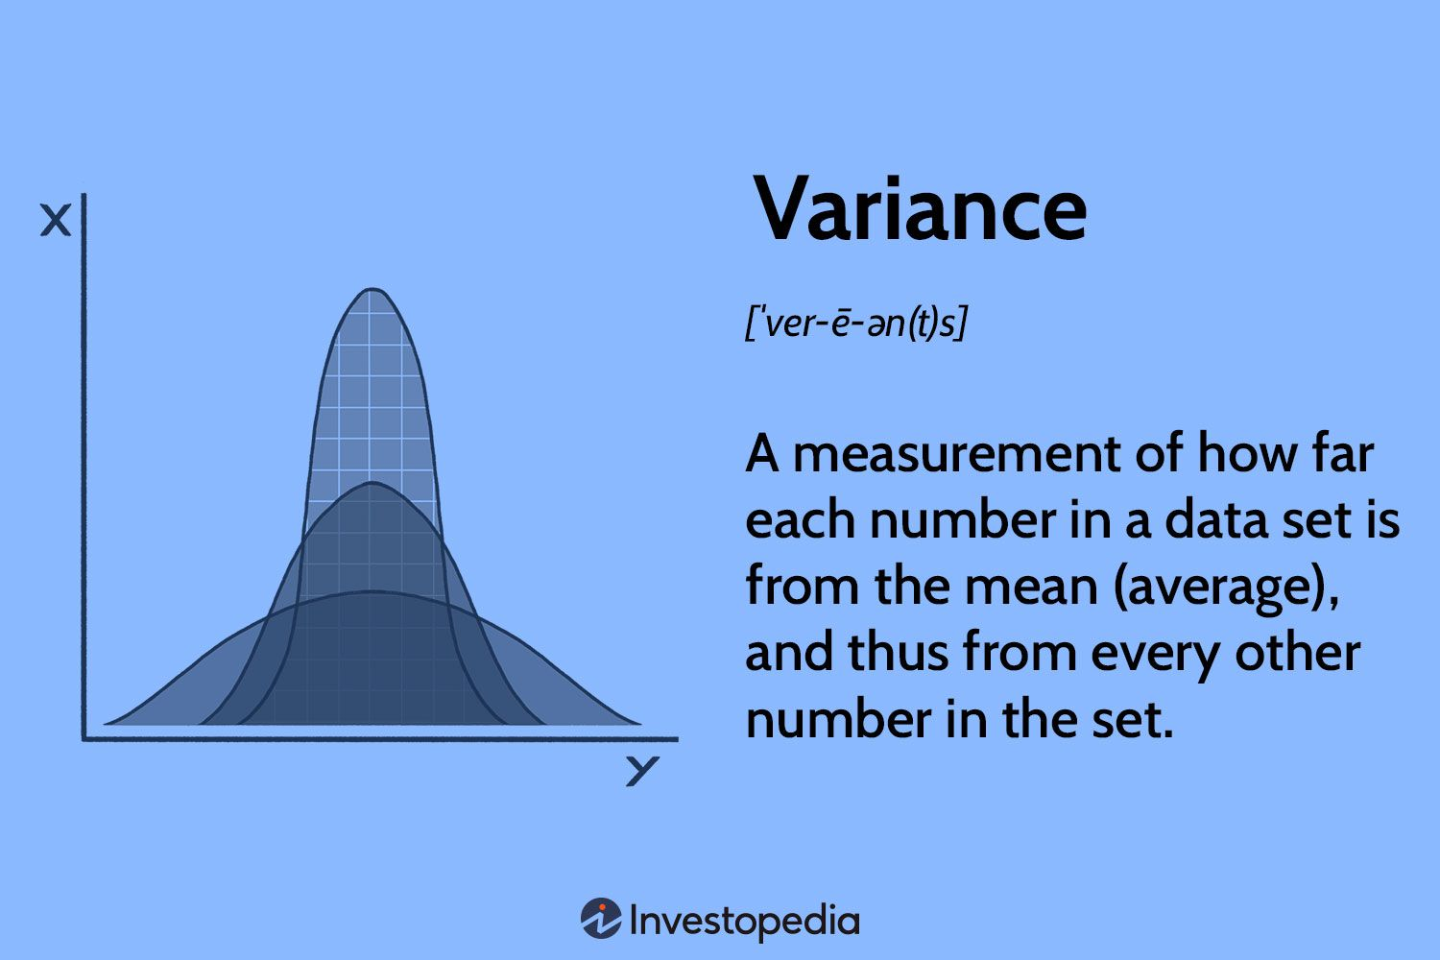
Variance
Notes:
Variance measures the average squared distance from the mean. It is expressed in squared units, making it less intuitive than standard deviation, but it’s essential for many statistical models and analyses. Higher variance indicates greater data spread.

Slide 34
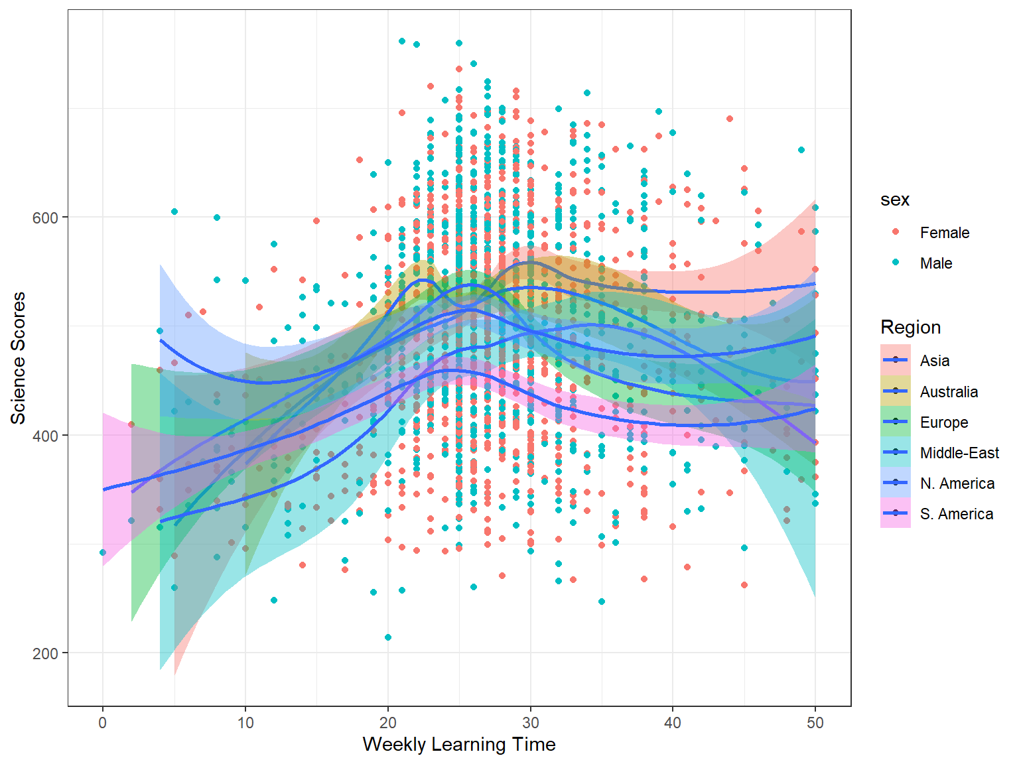
Variance
Notes:
Variance measures the average squared distance from the mean. It is expressed in squared units, making it less intuitive than standard deviation, but it’s essential for many statistical models and analyses. Higher variance indicates greater data spread.

Slide 35

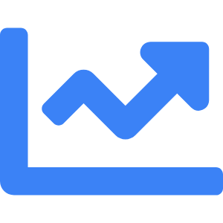
Standard Deviation
Square Root of Variance
Definition
Square root of variance, in the same units as data.
Interpretation
Represents average distance from the mean.
Applications
Quality control, finance risk assessment, and statistical inference.
Notes:
Standard deviation is the square root of variance. It tells us how far data points are, on average, from the mean. For example, σ = √4 = 2 means an average deviation of 2 units. It’s widely used in quality control, finance, and many other fields.

Slide 36
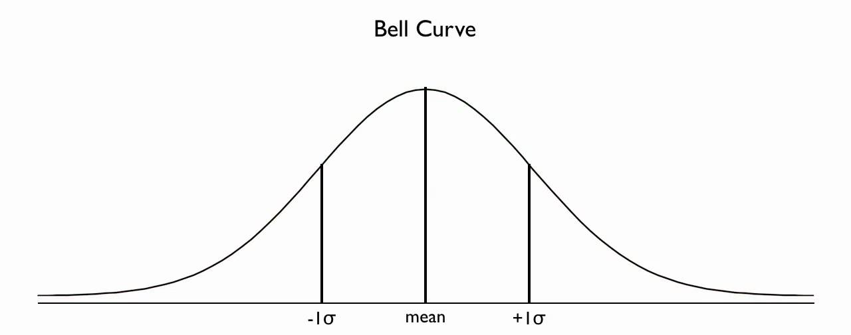
Standard Deviation
Square Root of Variance
Notes:
Standard deviation is the square root of variance. It tells us how far data points are, on average, from the mean. For example, σ = √4 = 2 means an average deviation of 2 units. It’s widely used in quality control, finance, and many other fields.

Slide 37

Standard Deviation
Square Root of Variance
Notes:
Standard deviation is the square root of variance. It tells us how far data points are, on average, from the mean. For example, σ = √4 = 2 means an average deviation of 2 units. It’s widely used in quality control, finance, and many other fields.

Slide 38

Standard Deviation
Notes:
Standard deviation is the square root of variance. It tells us how far data points are, on average, from the mean. For example, σ = √4 = 2 means an average deviation of 2 units. It’s widely used in quality control, finance, and many other fields.

Slide 39

Practical Examples & Visualization Ideas
Dispersion in Action
Box Plots: Show spread, quartiles, and outliers.
Histograms: Display distribution shape and frequency.
Scatter Plots: Reveal variability patterns between variables.
Photo by Isaac Smith on Unsplash
Notes:
Visuals make dispersion easier to understand. Box plots show spread and outliers, histograms illustrate distribution shape, and scatter plots reveal variability patterns across variables. These tools help identify trends, anomalies, and relationships in data.

Slide 40


Summary & Real-World Relevance
Complete Statistical Picture
Central Tendency + Dispersion
Together they provide a holistic understanding of data.
Decision-Making
Essential for accurate forecasting, quality control, and risk assessment.
Practical Applications
Used in business, healthcare, manufacturing, and research.
Notes:
In summary, measures of central tendency tell us where the center of data lies, while measures of dispersion explain how far data points can be from that center. When combined, they offer a complete statistical narrative that’s crucial for analysis and interpretation.\n\nThese concepts underpin accurate decision-making in domains like business forecasting, quality assurance, and risk assessment, enabling professionals to make informed, data-driven choices.

Slide 41


Summary & Real-World Relevance
Notes:
In summary, measures of central tendency tell us where the center of data lies, while measures of dispersion explain how far data points can be from that center. When combined, they offer a complete statistical narrative that’s crucial for analysis and interpretation.\n\nThese concepts underpin accurate decision-making in domains like business forecasting, quality assurance, and risk assessment, enabling professionals to make informed, data-driven choices.

Slide 42

Summary & Real-World Relevance
Notes:
In summary, measures of central tendency tell us where the center of data lies, while measures of dispersion explain how far data points can be from that center. When combined, they offer a complete statistical narrative that’s crucial for analysis and interpretation.\n\nThese concepts underpin accurate decision-making in domains like business forecasting, quality assurance, and risk assessment, enabling professionals to make informed, data-driven choices.

